Slide 1

The Crazy Monkeys Presents
DANGERCACHING
By Finn (@Gallefray), Rhys (@PendingChaos), Sam(@CheesyCDartyD)
Notes:
Finn:-
Introduce the team

Slide 2



Who are we?
Finn- Front-end, back-end, OS builder, compilers
Rhys - Real-time 3d graphics
Sam – Hardware, front-end, back-end
Who unfortunately could not make it.
Notes:
Finn: introduce yourself
Rhys: introduce yourself and apologise for sam

Slide 3
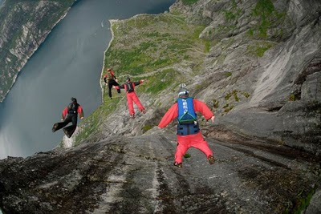
Are you a daredevil?
Notes:
Finn: read title

Slide 4

Introducing Dangercaching:
A unique twist of geocaching involving visiting highly active areas of crime within the United Kingdom. Raising yourself up the leader-board.
Notes:
Rhys explain

Slide 5
Why we have made this?
For our own fun
Always read the small print
We are not responsible for any injuries/deaths from using our idea.(Use at your own risk)
Notes:
Finn

Slide 6
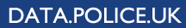



What have we utilised
Notes:
Rhys explain google maps, python and data
Finn explain frontend

Slide 7
Next Steps
Addition of more features
Develop a mobile application
Improve User Interface

Slide 8
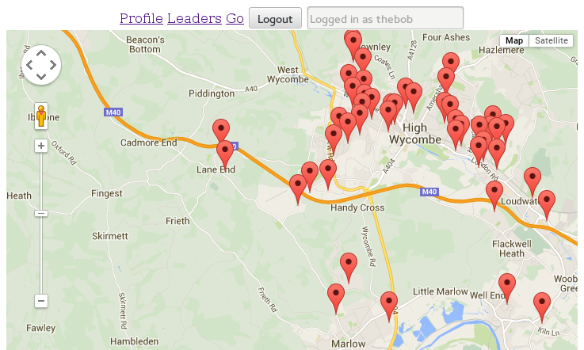
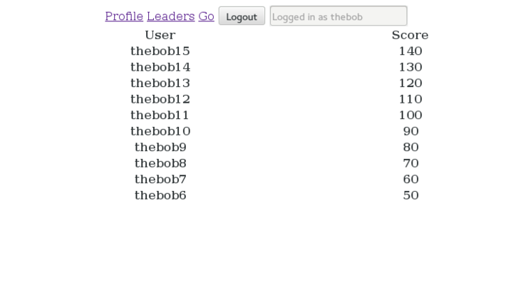
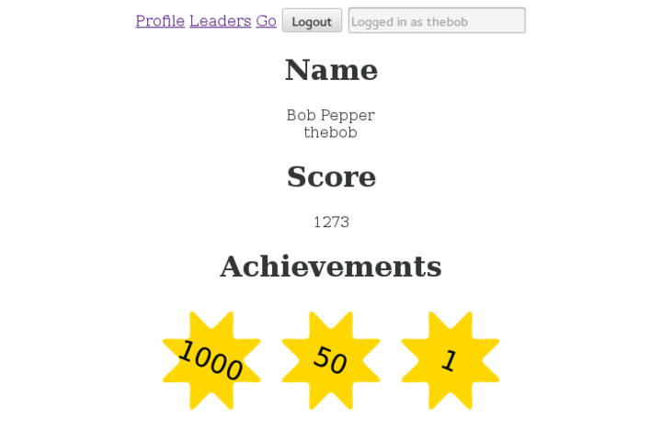

Slide 9
Thank You for Listening
Notes:
Rhys end it

Slide 10
Question Time

